Slide 1
Weekly report: Grid Code Development
Week number: 10
Date: 02/12/2025
Supervisor: Prof. Dr.-Ing. Saiju
Presented by: Vijay Bogala / Josef Remberger

Slide 2
List of contents
Protection of wind turbine
Power factory workflow
Wind farm control
Vijay Bogala

Slide 3
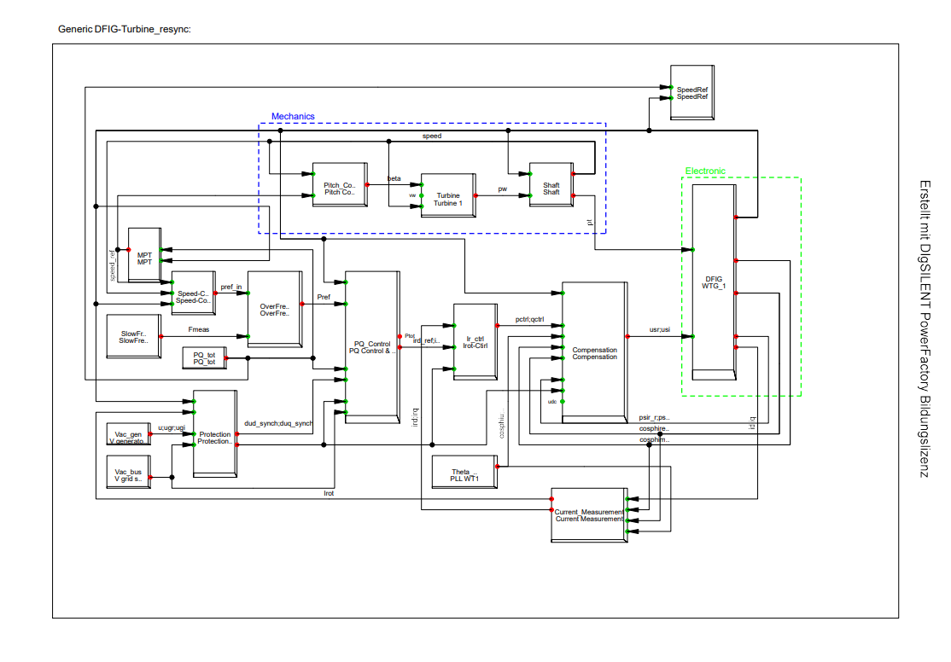
1. Protection of wind turbine
Overall Control circuit of wind turbine
[1] PowerFactory, 2025
Vijay Bogala

Slide 4
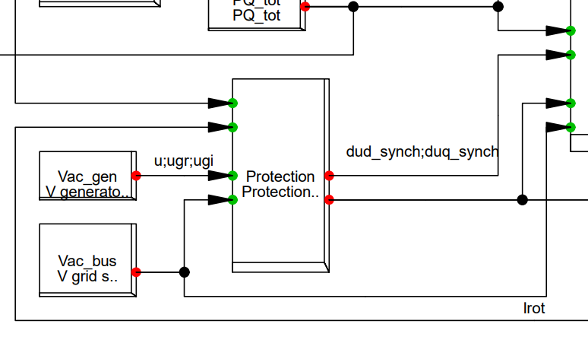
1. Protection of wind turbine
Souce: own with PowerFactory
Vijay Bogala

Slide 5
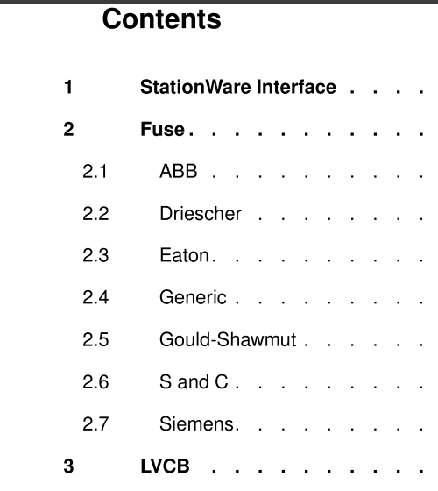
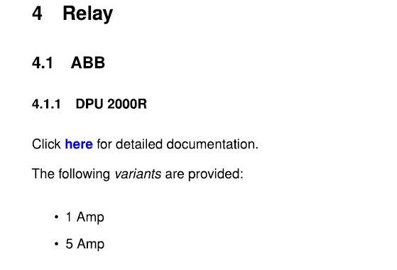

1. Protection of wind turbine
[2] PowerFactory, 2025
Vijay Bogala

Slide 6
2. Power factory workflow
Build the elements such as
  Turbine: Generator, Transformer
  Grid: Transformer, equivalent external grid, shunt lines with switches for short-circuit
  Control circuit
Define Simulation event based on calculation such as
  Run the model to a stabilised point such as 1 pu rated P
  Cause 3-phase short circuit in grid at shunt line at 1 sec.
  Remove it at 1.15 s.
Define the point & quantity of measurement, ex. 3-phase balanced current, reactive power at transformer terminal, voltage etc.
Choose the type of simulation: Load flow analysis, balanced/unbalanced RMS, EMT.
Building graphs and repeat for many other such events.
Vijay Bogala

Slide 7
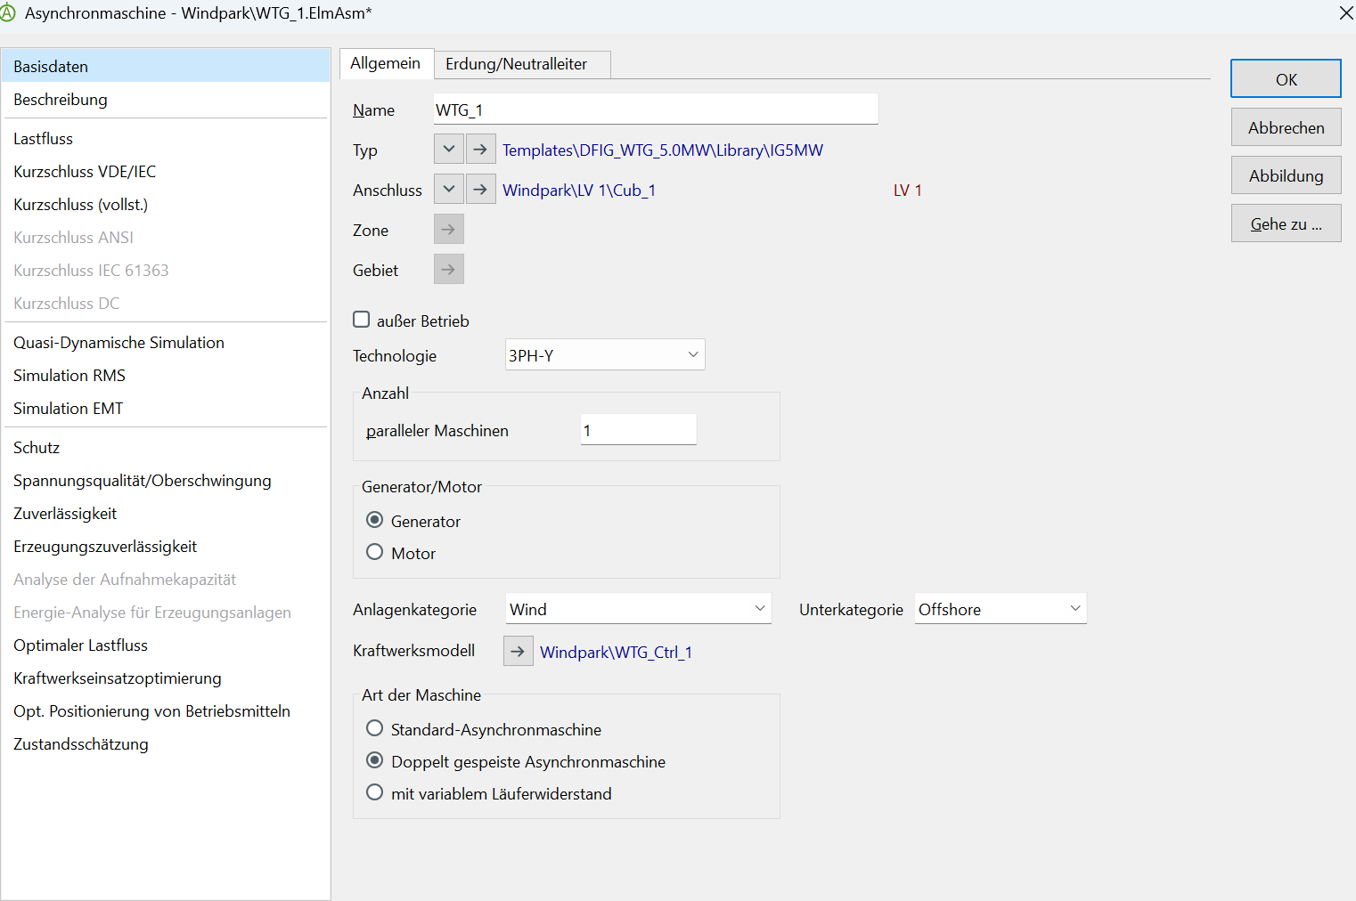
2. Power factory workflow
Souce: own with PowerFactory
Vijay Bogala

Slide 8
3. Wind farm control
  Nos. of turbines: 3
  i.e. PPC / Power Plant Controller
    Controls the power fed into grid based on requirement
    Stabilises the grid to keep selling power
    Connects all equipment on the farm with grid: Turbines, farm transformer, storage, STATCOM, capacitor/inductor banks.
  Syrian grid has classical real-time control on renewable power plants as in ii., only difference in the method of communication as wireless in stead of optical fibre.
Vijay Bogala

Slide 9
3. Wind farm control
State-of-the-art control features [3, vestas]
  Power factor or reactive power closed-loop control (two options)
  Voltage closed-loop control
  Active power closed-loop control, curtailment, derating, ramp-rate limitation
  Frequency control (three options), governor response
  Fault ride-through coordination
Additional equipment:
  STATCOM: Static Synchronous Compensator
  MSC: Mechanically Switched Capacitor
  MSR: Mechanically Switched Reactor
[3]
Vijay Bogala

Slide 10

Bibliography – Grid Code Development
[1] “Generic_DFIG_turbine_resync”, PowerFactory, (accessed Nov. 24, 2025)
[2] “Protection device library,” PowerFactory, 2025 (accessed Dec. 1, 2025)
[3] “Dedicated for wind power plants.” Available: https://www.vestas.com/content/dam/vestas-com/global/en/brochures/power-plant-solutions-/VestasOnline_Power_Plant_Controller.pdf.coredownload.inline.pdf (accessed Dec. 1, 2025)
‌

